Slide 1
Analysing News Website Live Data
(Searching & Ranking Web Pages )
BY: Rajshri totla

Slide 2
AIM
Required Task:
  Searching and Ranking given set of web pages
Additional Task:
  Analysing data on different levels
    All pages altogether
    Each web page

Slide 3
R Packages
tidyverse [General-purpose data wrangling]
stringr [String manipulation]
stringi
tm
SnowballC
RColorBrewer [wordcloud]
Wordcloud [wordcloud ]
stringdist
Cluster
htm2txt [to extract data]
googleVis [gvisBubbleChart function]

Slide 4
News Websites
The Wall Street Journal ['https://www.wsj.com/']
NBC News ['https://www.nbcnews.com/']
USA Today ['https://www.usatoday.com/’]
BBC ['https://www.usatoday.com/’]
LA Times ['https://www.usatoday.com/]
Huffington Post [https://www.huffpost.com/][
Fox News ['https://www.foxnews.com/']
Reuters ['https://www.reuters.com/’]
Google News [‘https://news.google.com/?hl=en-US&gl=US&ceid=US:en’]
Yahoo News [‘https://news.yahoo.com/’]

Slide 5
Text Mining Implementation
Accessing Web Pages
Extracting textual content
Pre-processing
Staging the data (DTM)
Explore The Data
Analysis [Dendogram, Wordcloud, Google Plots, Barplot]

Slide 6
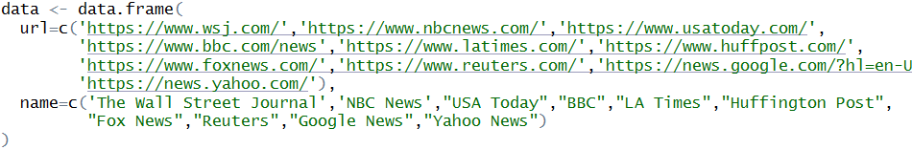
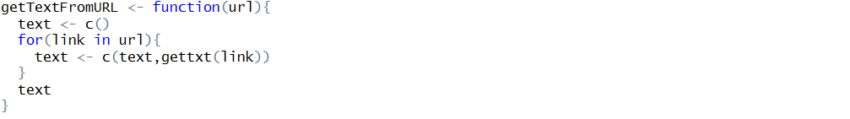
Accessing and Extracting the Text Data

Slide 7
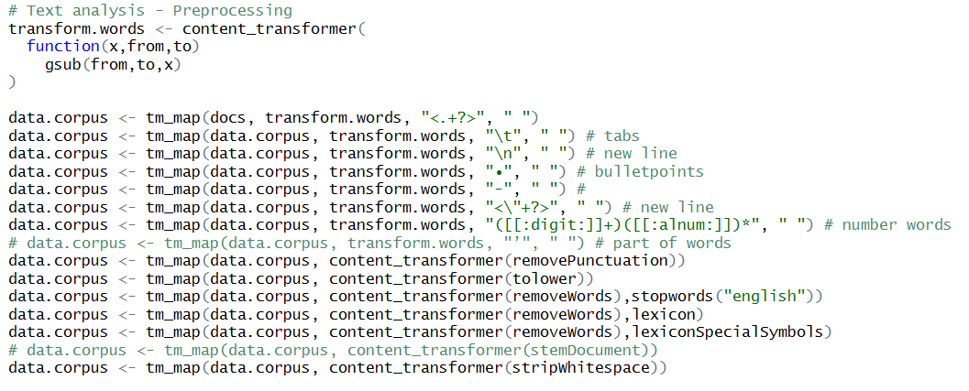
Pre-processing & Staging
Created lexicon files to remove common works and symbols

Slide 8
Explore & Analysis

Slide 9

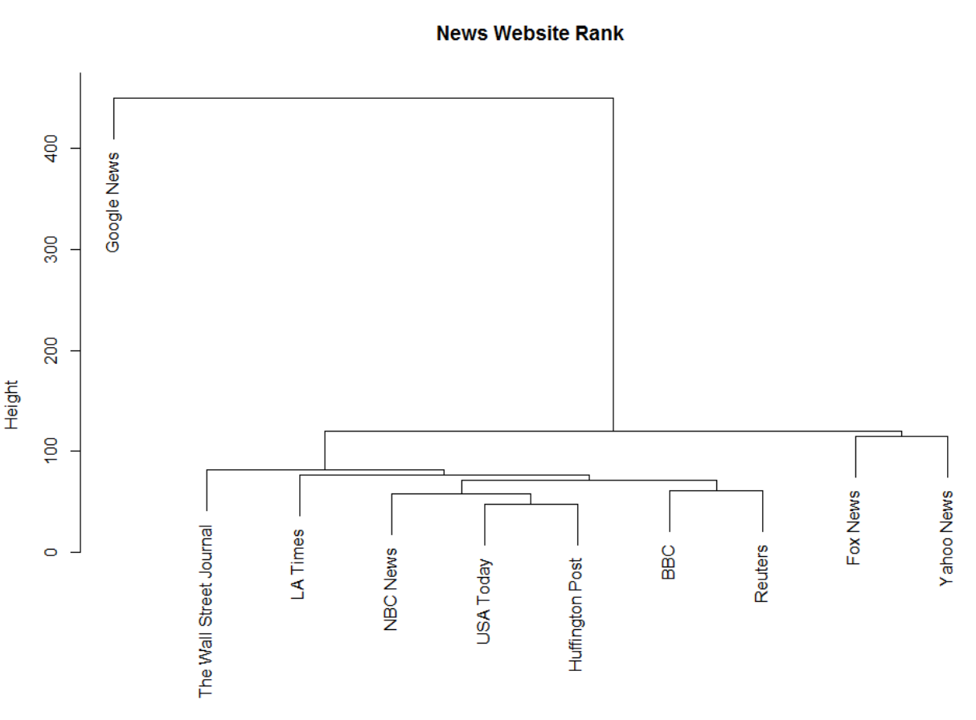
DENDOGRAM
- without stemming
- using hclust

Slide 10
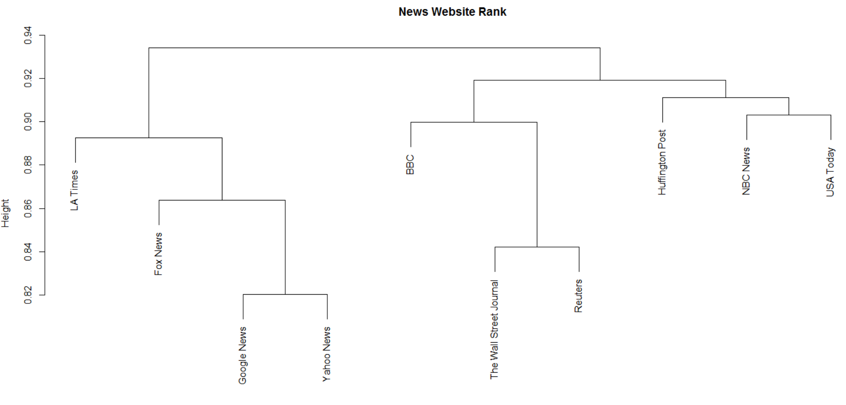
DENDOGRAM
- with stemming
- using Jaccard Distance

Slide 11
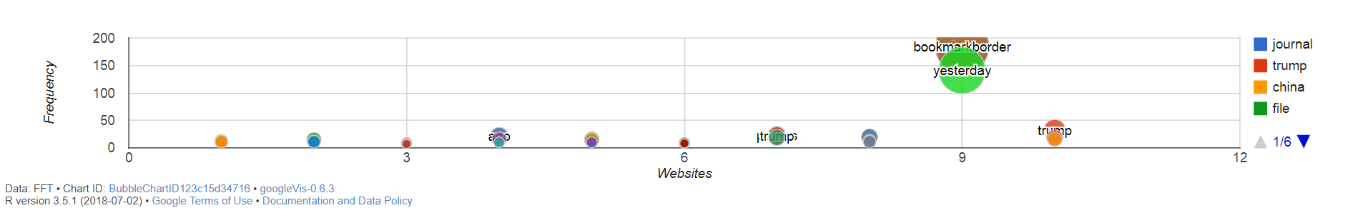
Google Visualization Plots

Slide 12
Word Clouds

Slide 13
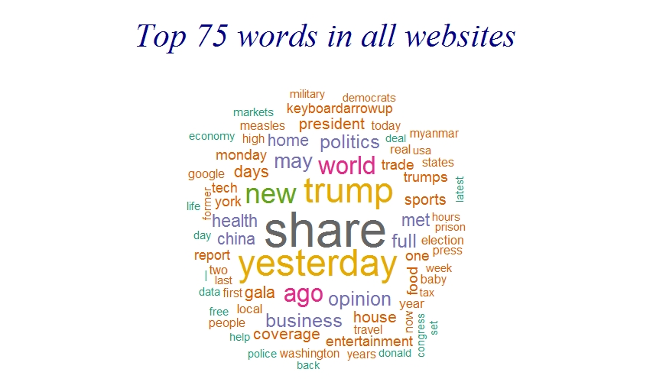

Slide 14
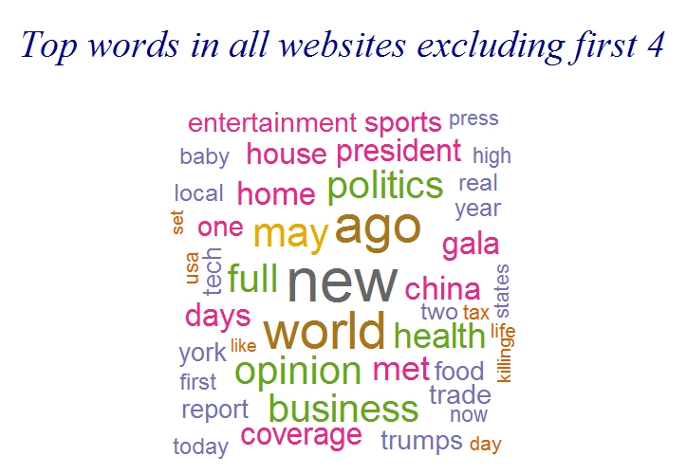

Slide 15
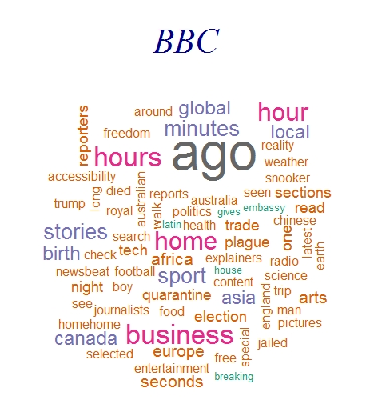
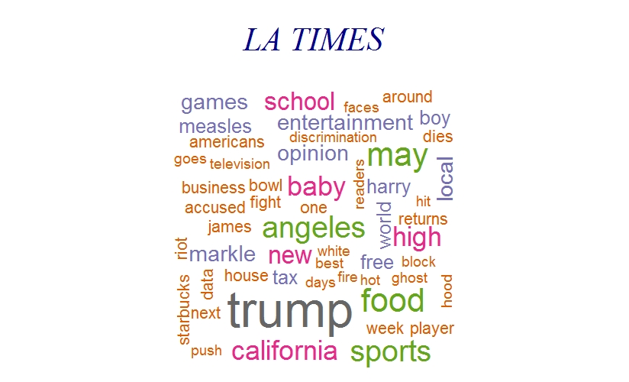
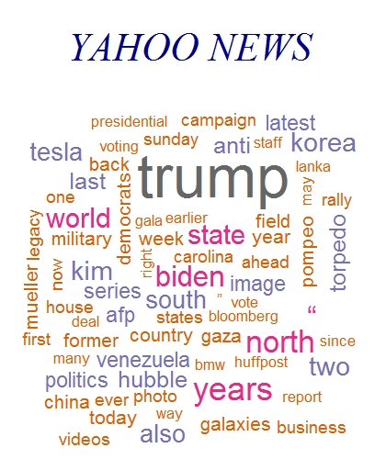
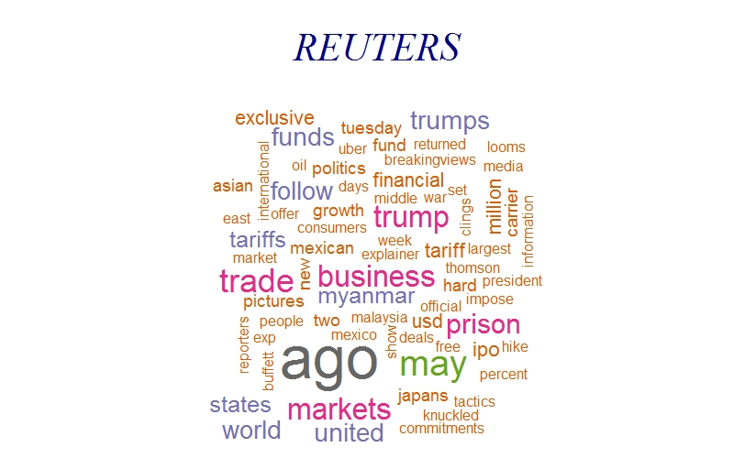
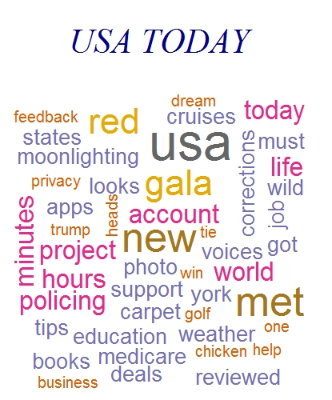
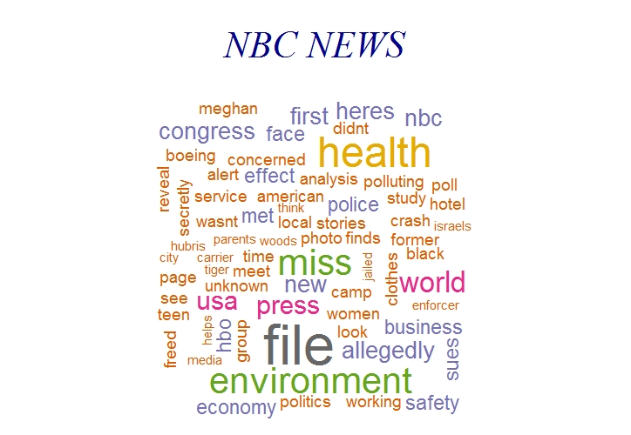

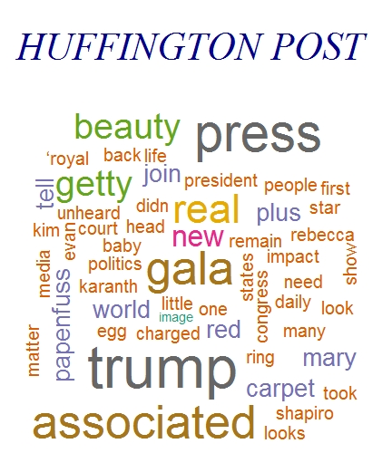
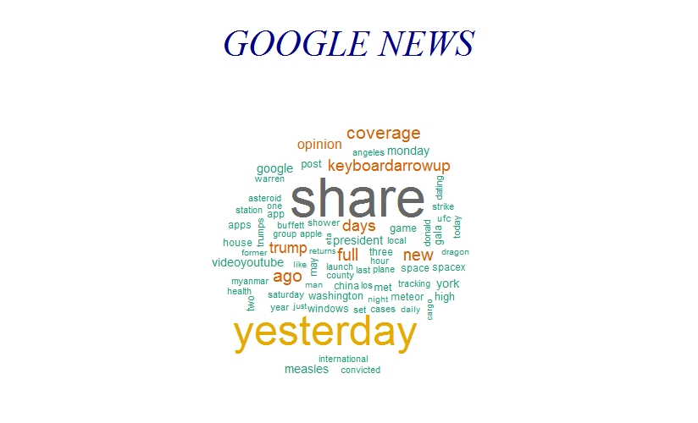
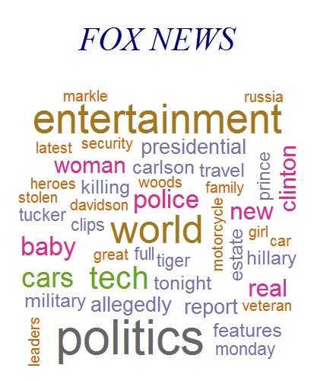

Slide 16
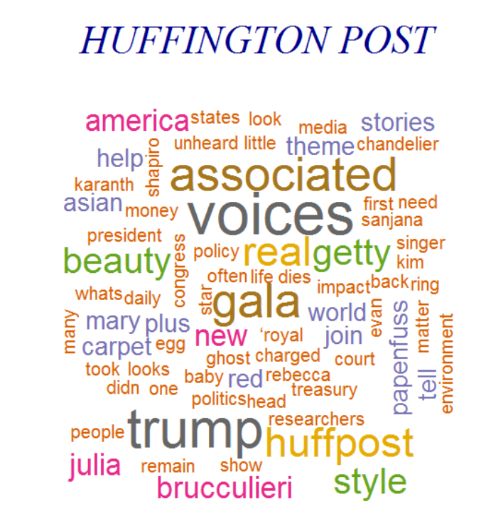
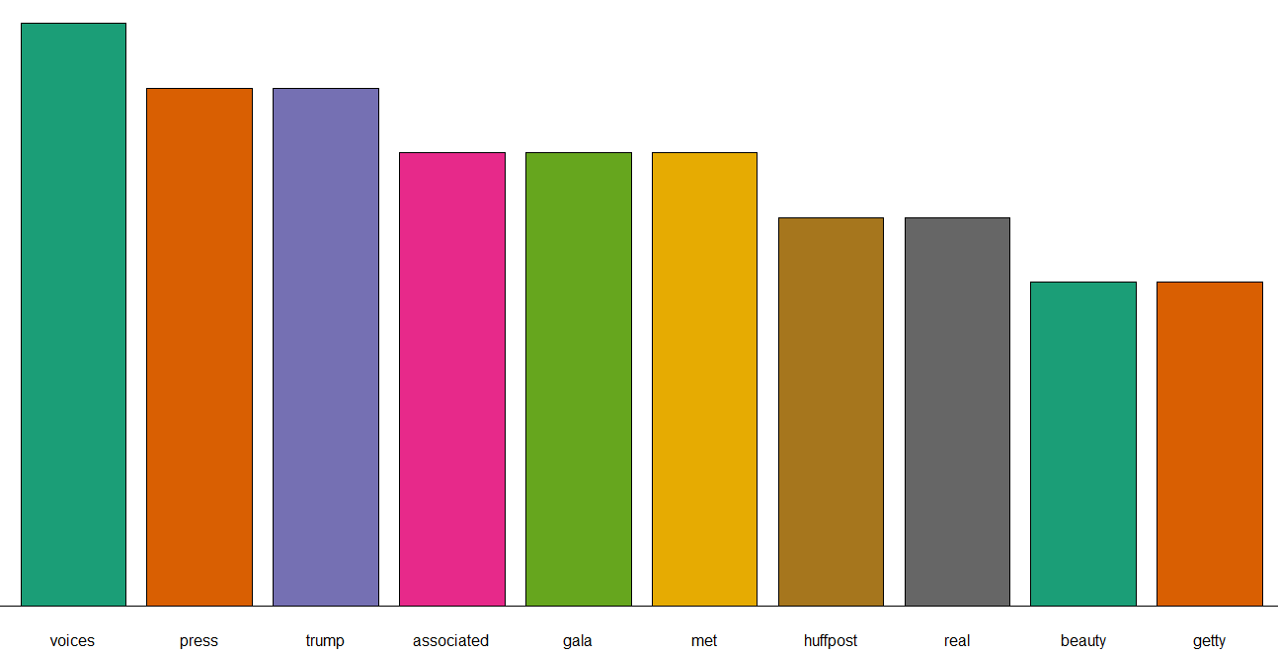
Huffington Post | 3/5

Slide 17
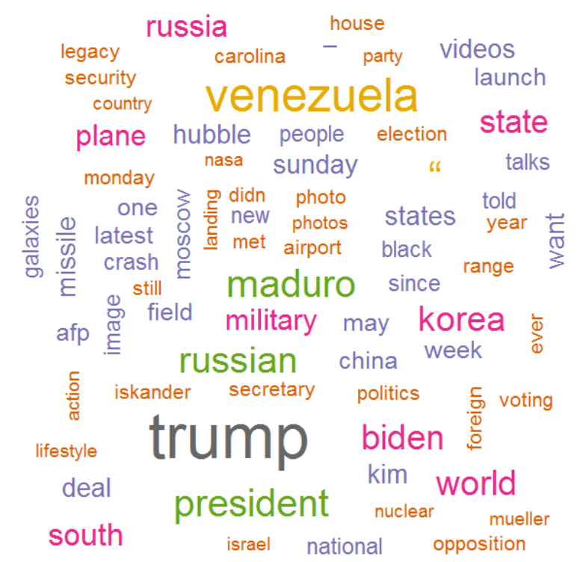
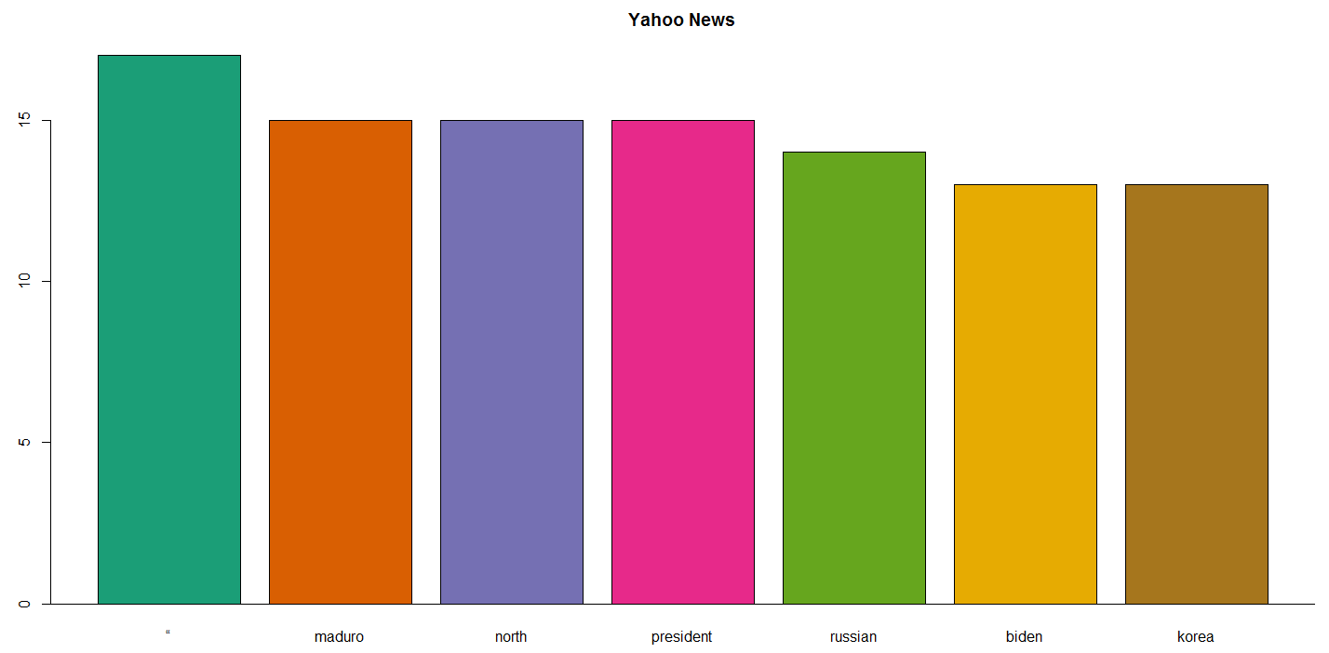
YAHOO 4/5

Slide 18
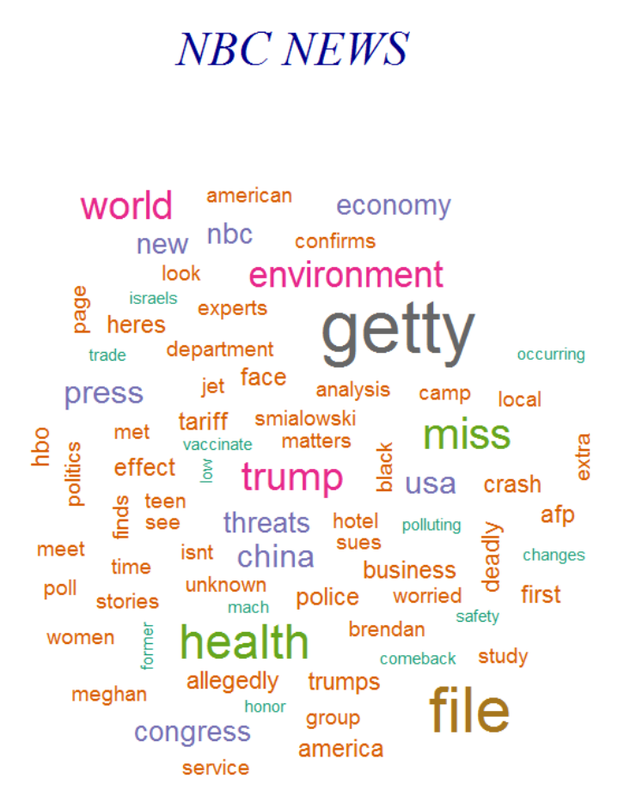
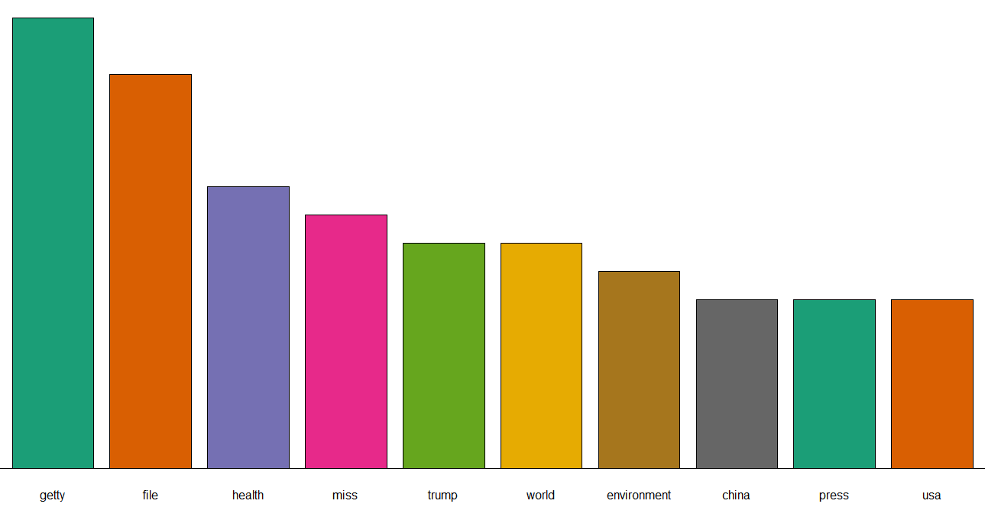
NBC | 4/5

Slide 19
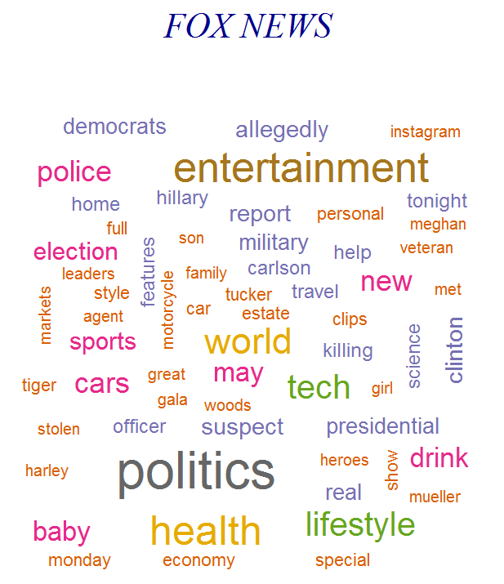
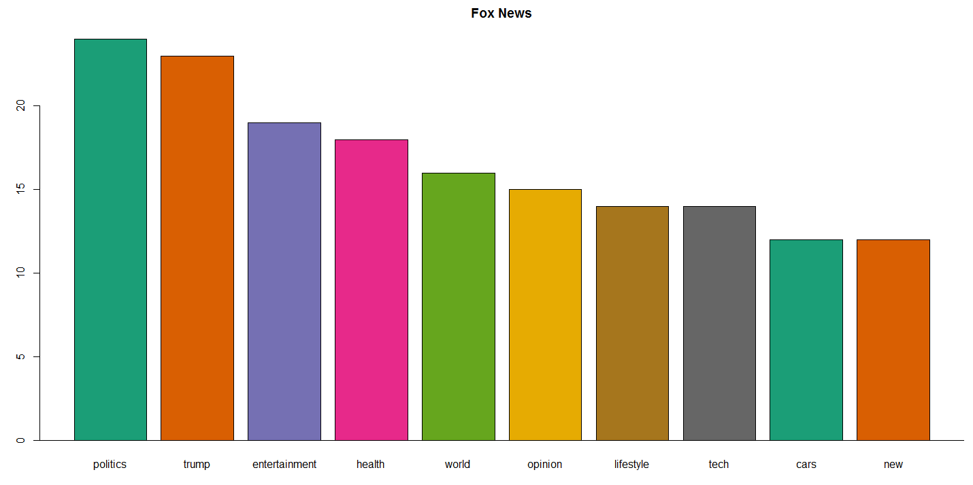
Fox News | 4/5

Slide 20
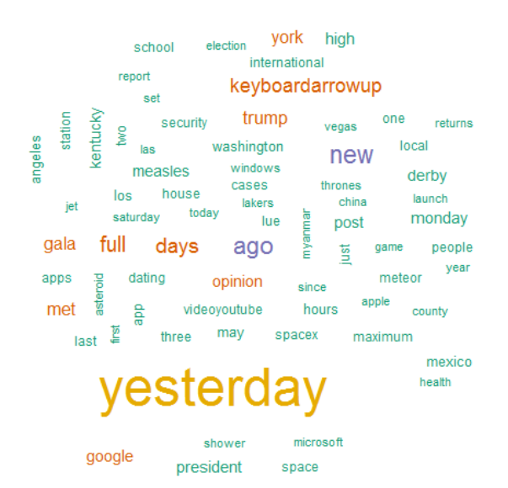
GOOGLE
NEWS
5/5

